Slide 1
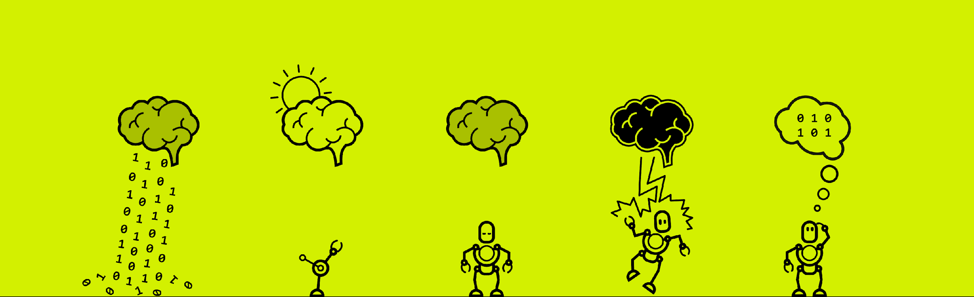
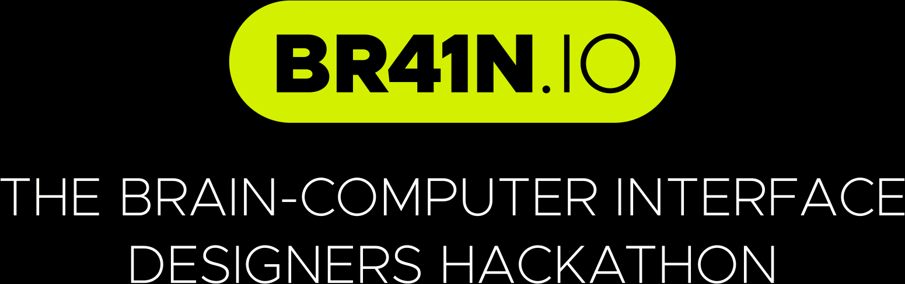

G28
Notes:
TIME LIMIT IS 2MINS 30 SECONDS :D

Slide 2


EEG-Maze: Controlling a 2D Maze game using a P300-based BCI
Apurva Singh, Ashka Shah Jaspreet Dodd, and Sahana Radha
G28
Notes:
TIME LIMIT IS 2MINS 30 SECONDS :D

Slide 3
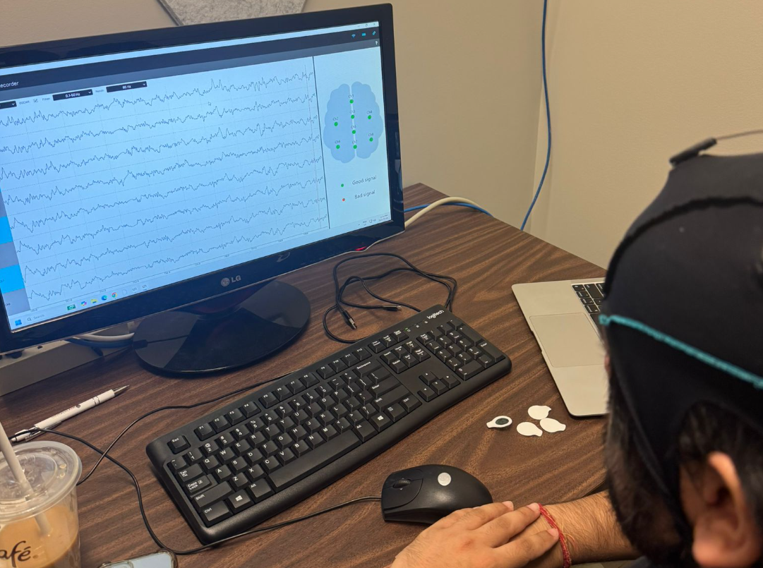
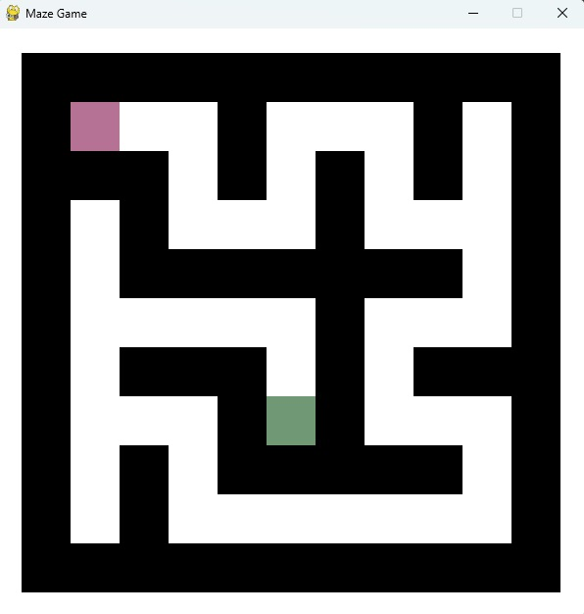
Bridging thought and action…
Situation
What if you could navigate a 2D maze using nothing but a top-down view?
g.tec Unicorn Hybrid + Customized P300 Speller:
A hands-free gaming experience!
Motivation
Demonstrate how brains signals can be converted into intuitive commands.
Explore P300 as a tool for control mechanism in BCIs.
Testing signal quality!
G28
Maze Game ¹
Notes:
Our team set out to build a real-time Brain-Computer Interface (BCI) game that allows users to navigate a 2D maze using EEG signals alone — no keyboard or controller input.
We used the g.tec Unicorn Hybrid EEG headset and its built-in P300 speller module to train a classifier that detects visual attention toward flashing directional cues (↑, ↓, ←, →). These classifier outputs were then used to control the maze player.
The motivation behind our project was to… (read the slide. lol)

Slide 4
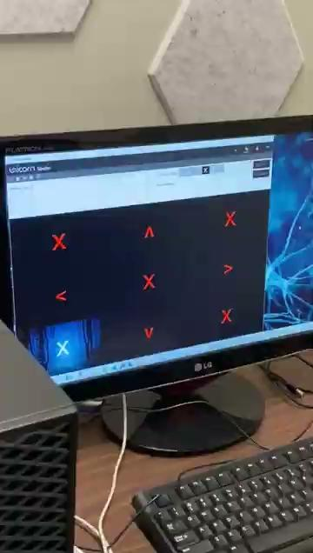
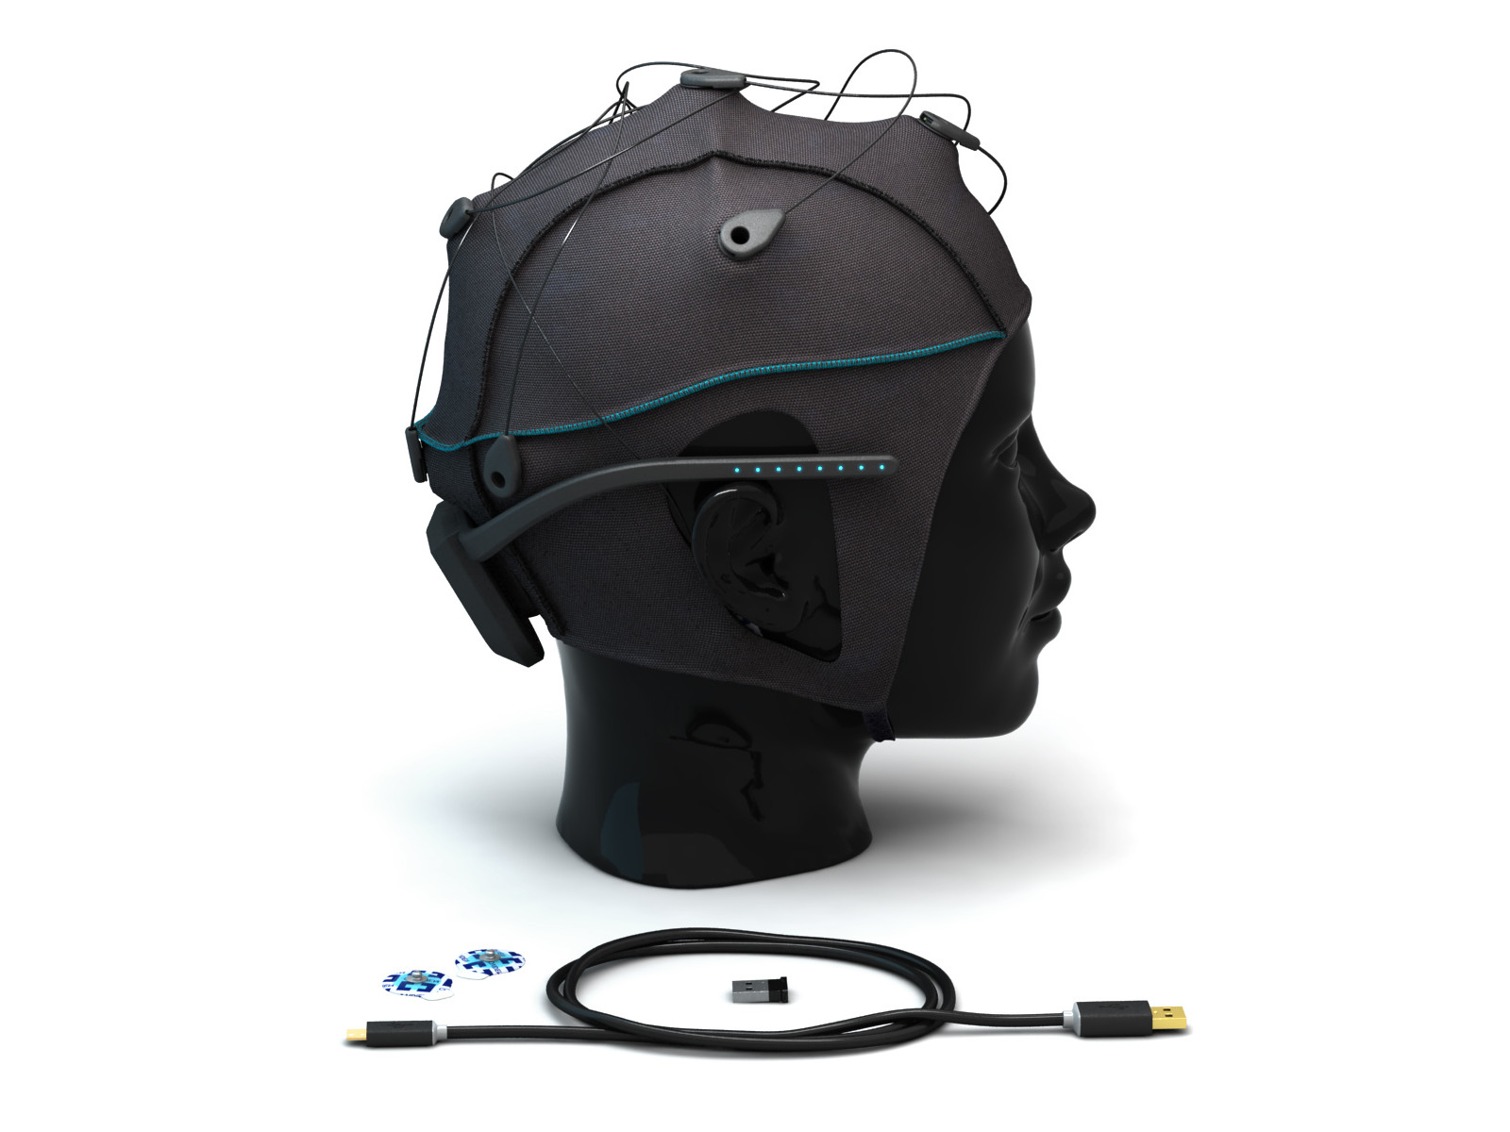

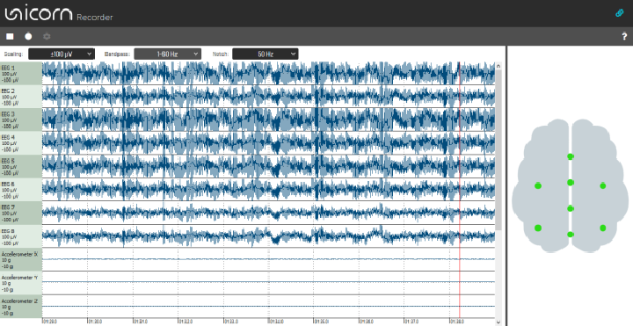

Bringing our tools together…
Core Idea
Use P300 event-related potentials to control user’s movement.
Train classifier on the four arrow keys using salient stimuli to evoke strong P300 signals.
UDP/LSL stream
Classifier output sent to PyGame
Unicorn Hybrid Headset
Unicorn Suite
Filter and P300 classifier
PyGame
On-screen movement
Training the classifier
G28
Notes:
Our solution transforms attention into action by coupling the P300 speller’s classifier output with a real-time 2D maze game.
Read the core IDEA/SOLUTION to the presented SITUATION in the slide before. Then walk them through the steps of creating the BCI-gaming application:
> Signal acquisition via Unicorn Hybrid EEG headset
> Signal processing and classifier training via P300 speller module in Unicorn Suite.
> Sending classifier-output data via UDP/LSL to PyGame and creating a responsive interface.
> Game control!

Slide 5
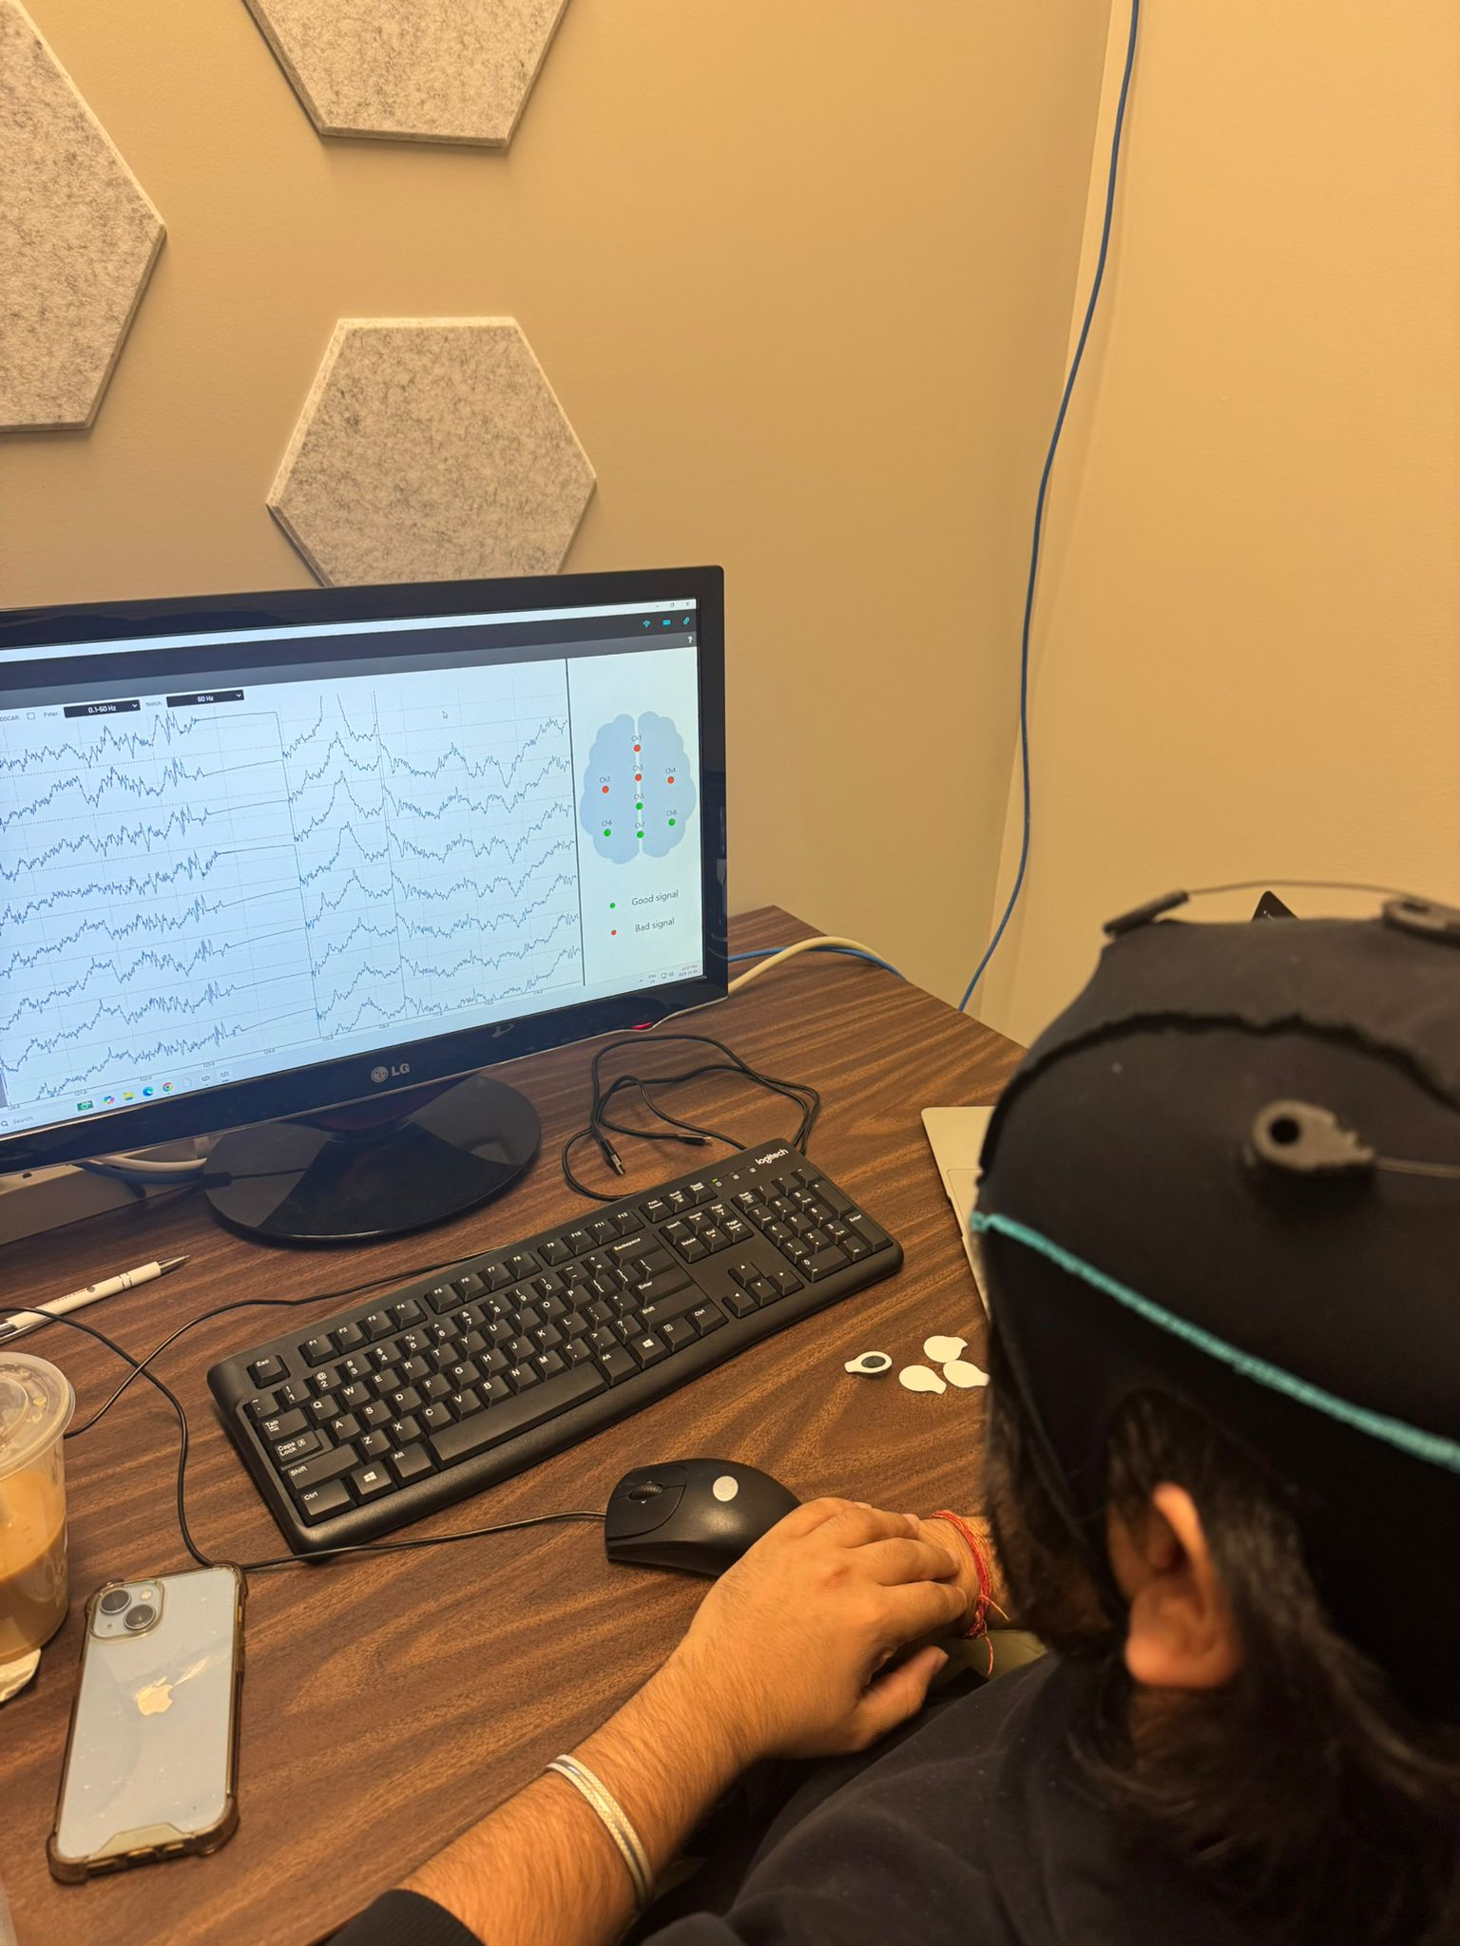

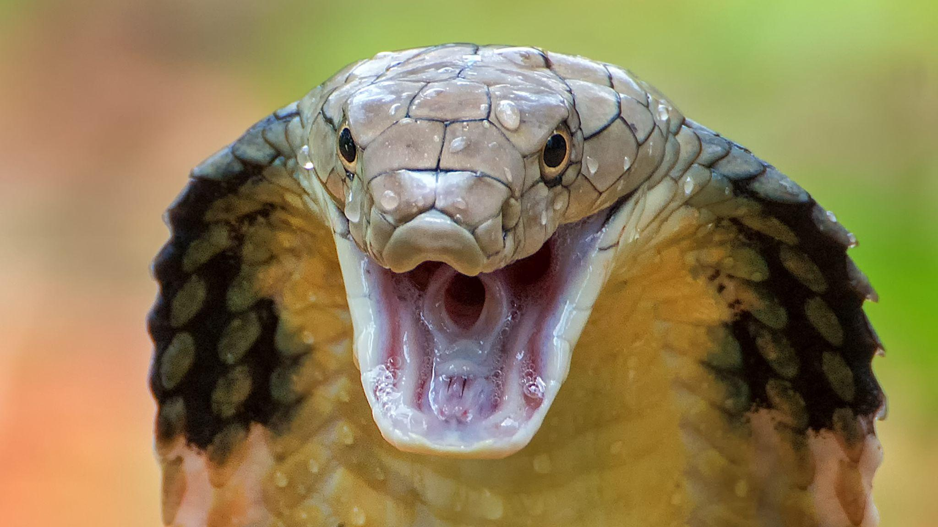
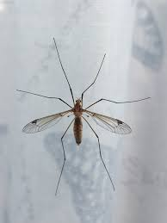
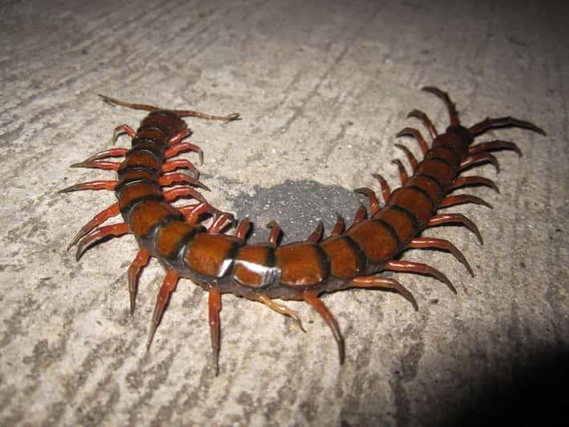
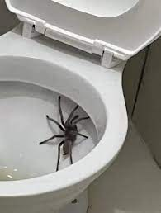
Getting things right… takes time!
Pipeline development
Setup and Calibration 😵
OSCAR artifact removal saved us hours!
(2) Maximizing the P300 signal 📈 as per the literature →
Salient visual cues (insects, reptiles, spooky)
Tuning stimulus timing (ISI =0.75s, Flash = 0.2s)
P300a vs. P300b (target vs. non-target discrimination)
(3) Signal integration and parsing
Created script to parse LSL output and reduce processing time
(4) Debugged data latency
Dual-monitor vs. single-monitor comparison for response latency
Fear increases P300 response!
G28
Notes:
“We built, trained, and integrated a functional EEG-to-game control pipeline from scratch — debugging every link from classifier training to real-time signal parsing under hackathon time pressure.”
If wanted, explain
ISI = Inter-stimulus interval
Flash duration = 200ms

Slide 6
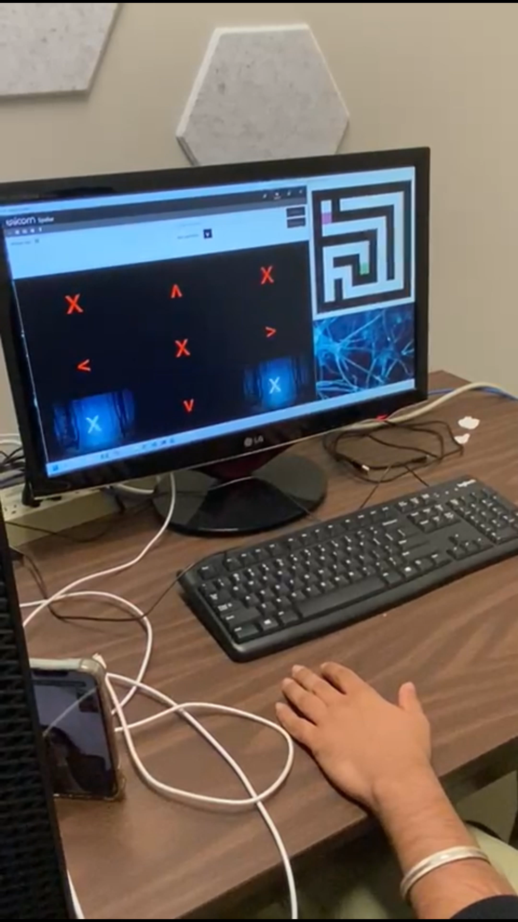
Drum Roll…?
What we can improve on:
What we celebrated:
3-directional control
18 correct classifications in a row!
Sub-300 ms latency
4th direction (UP) key registered in classifier but not transferred to game via UDP.
Improve classifier accuracy and reduce #flickers for game-input for faster gameplay!
More spooky/scary visuals! :D
G28
Demo of functional P300-based Maze
Notes:
Despite limited time and hardware hiccups, our prototype achieved stable real-time control in three directions — showing that even a small team can build a working closed-loop BCI game pipeline within a single hackathon.

Slide 7
Looking back at our efforts
Some of the things we learned from this experience…
About BCIs…
> EEG-game integration is highly sensitive to latency
> Classifier performance depends not just on the model, but also the UI design!
> Modular design and interfacing across serves is key for efficiency
And not just only about BCIs..
> Ambition with Realism lets us create a Minimally Viable Prototype (MVP) that serves as a foundation for next-steps
> Celebrating every little win makes its easier to deal with the hiccups!
G28
Notes:
The biggest lesson wasn’t about EEG or code — it was about systems thinking: how every layer, from neural signal to network packet, needs to talk to each other in real time.

Slide 8
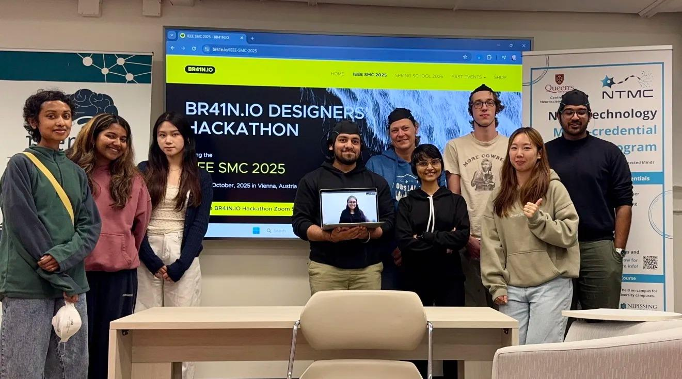
Fun times at QueensU!
Special thanks to:
Dr. Susan Boehnke
Dr. Ethan Heming
TA Matthew Jacobs
G28

Slide 9
EEG-Maze: Controlling a 2D Maze game using a P300-based BCI
Apurva Singh, Ashka Shah, Jaspreet Dodd, and Sahana Radha
G28

